Slide 1





Practically Speaking: Practical Suggestions for Retreats with Young People

Slide 2
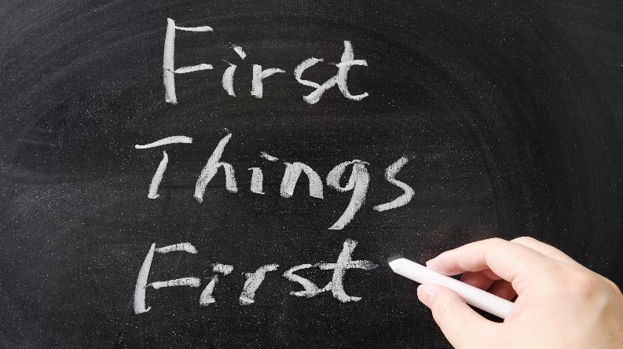
The Very First Things
Raywoo/Shutterstock.com

Slide 3
1. What’s your welcome?
2. Where do they sit?
3. What is ‘bell work’?

Slide 4

What’s your welcome?
Signage – clear and lots of it!
Put people at the door for a personalized welcome.
Have name tags.
woaiss/Shutterstock.com

Slide 5

Where do they sit?
Assigned seats or sit where they choose?
Tables and chairs or just chairs?
Monkey Business Images/Shutterstock.com

Slide 6
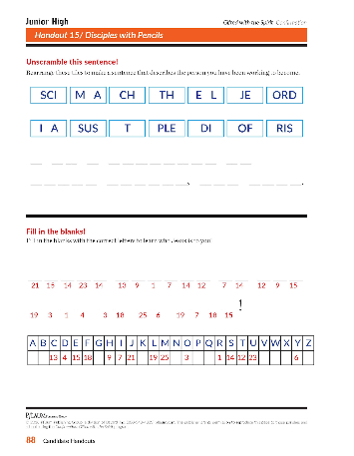
What is ‘bell work’?
An activity that occupies participants as they arrive and as we wait for everyone to be there to begin our program.
Bell work needs to be self-explanatory, on task, low risk.

Slide 7

Keeping It Moving … And Positive
ESB Professional/Shutterstock.com

Slide 8
It’s all about the positive force!
1. The Force of the Lesson Going Forward
2. The Force of Your Presence
3. The Force of Positive Reinforcement

Slide 9
The Force of the Lesson Going Forward
  Strong or weak? Organized or Falling Apart?
  Are you a confident leader?

Slide 10

The Force of Your Presence
Zurijeta/Shutterstock.com

Slide 11

The Force of Positive Reinforcement
Monkey Business Images/Shutterstock.com

Slide 12
How To Keep It Organized

Slide 13
1. Multi - Colored activity pages
2. Balance of movement vs. sitting activities
3. The right materials at the right moment – minimizing distractions
4. Logistics and crowd movement

Slide 14

Multi-colored activity pages
Gayvoronskaya_Yana/Shutterstock.com

Slide 15
Balance of Activities
Listening, Speaking, Sharing in Groups, Journaling, Activity Sheets, Role Plays, Breaks, Snacks, Group Games..

Slide 16

The Right Materials at the Right Time
Think how to minimize distractions
Jakub Zak/Shutterstock.com

Slide 17
Logistics and Crowd Management
Where do they put their belongings?
How do they move?
  Into groups or to find a partner
  From one room or space or activity to the next

Slide 18


“Practically speaking” anyone can have an improved retreat experience by implementing these 10 tips!
Enjoy your day!
YanLev/Shutterstock.com

