Slide 1





Planning a Confirmation Retreat

Slide 2
Learning to Plan in Blocks
Planning in blocks means:
You can visualize the day as distinct activities.
No one activity needs to be too long.
You can see where the breaks naturally occur.
You can balance more relaxed activity with times of greater focus, quieter activities with more active games.

Slide 3
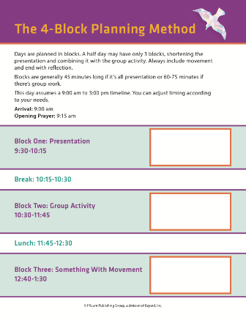
Begin your plan with the planning sheet provided with this video

Slide 4
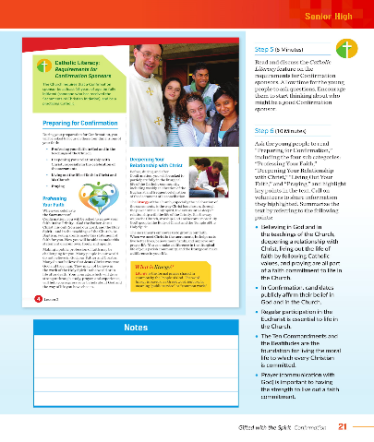
Notice the flow of the day
It begins with a presentation:
  This is the moment to present a ‘lesson’ or give content.

Slide 5

Don’t leave them sitting and listening too long
Allow for a group activity.
PORTRAIT IMAGES ASIA BY NONWARIT/Shutterstock.com

Slide 6

Following the break or lunch –
Get them moving!
This could be a good time for role playing or charades.
Matt Hayward/Shutterstock.com

Slide 7
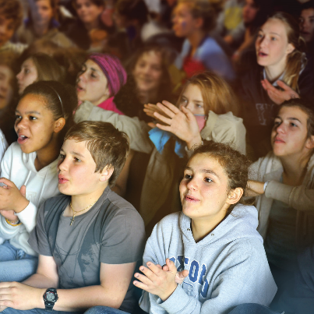

End by bringing them back
Bring the energy back to the theme and the purpose of the day.
AVAVA/Shutterstock.com

Slide 8


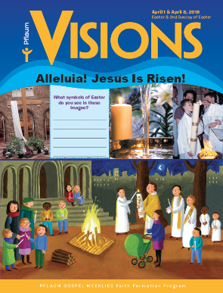
Now you have the flow of the day … what’s your content?

Slide 9
Gifted with the Spirit (Junior High Edition)
Materials from Lesson 1
and 2.
Block one 9:30 – 10:15 Presentation
Break 10:15 – 10:30
Block two 10:30 – 11:45 Group Activity
Lunch 11:45 – 12:30
Block three 12:40 – 1:30 Something with movement
Break 1:30 – 1:45
Block four 1:45 – 2:30 Something reflective
Group work using the Gifts of the Spirit from Lesson 5
Charades or Role Plays using the works of mercy from Lesson 4
Movie or music clip with journaling

Slide 10
Gifted with the Spirit (Senior High Edition)
Materials from Lesson 1 on the Sacraments of Initiation
Block one 9:30 – 10:15 Presentation
Break 10:15 – 10:30
Block two 10:30 – 11:45 Group Activity
Lunch 11:45 – 12:30
Block three 12:40 – 1:30 Something with movement
Break 1:30 – 1:45
Block four 1:45 – 2:30 Something reflective
Group discussion using the activity from Lesson 3 on the Creed
Charades or Role Plays using the discipleship lessons from Lesson 5
Movie or music clip with journaling incorporating insights around prayer from Lesson 2

Slide 11


Slide 12
Gifted with the Spirit Confirmation Program
Sacraments are always moments of Evangelization.
Think of how to include the whole family.
On the Day...

